Slide 1
Computability Theory
CSC3113: Theory of Computation
8
8
Fall 2023-2024
Sharfuddin Mahmood, Assistant Professor,
Department of Computer Science, Faculty of Science & Technology.
smahmood@aiub.edu

Slide 2
Computability & Turing Machine
Following FA, PDA, Regular & Context-free language towards Computability & Turing Machine (TM).
Computability Theory, History.
Turing Machine
Informal Description
Input/output convention

Slide 3
Difference among FA, PDA, and TM
Understand Computability Theory through Turing Machine model.
Description of Turing Machine

Slide 4
All outcome are represented with examples
Understand why we need TM through understanding the difference among FA, PDA, Regular & Context-free languages with Computability and Turing machine.
Basic concept of Computability Theory and its history.
Description of Turing Machine –
Informal
Implementation level
Low level
Formal
State Diagram

Slide 5
We have Learned so far…
Context Free Languages
Regular Languages
Push Down Automaton (PDA) Computational Model with additional stack memory can be used to compute these languages.
Regular language is member of CFL.
Can be generated by CFG.
Can be recognized by PDA.
CFG can be decided by PDA.
Finite Automaton (FA) Computational Model with limited memory can be used to compute these languages.
Can be decided by a DFA.
Can be decided by an NFA.
Can be expressed by a regular expression.
Regular language is closed under regular operations.
Pushdown automata is used in programming languages, AI tools, Natural Language processing, parsing (math expressions), etc.
Finite automata is used in text processing, pattern matching, parity checking, compilers, and hardware design, etc.

Slide 6
Next: We will Learn
Computable
Can be decided by a Turing Machine (TM).
A model of computation that is –
General purpose: Captures all algorithms that can be implemented in any programming language.
Mathematically simple: We can hope to prove that things are not computable in this model.
Turing Machine is deterministic
Must reach Accept/Reject state
Halts once it reaches Accept/Reject state
Might loop forever
Context Free Languages
Regular Languages

Slide 7
Computability Theory
A mathematical problem is computable if it can be solved in principle by a computing device.
In the 1930’s, well before there were computers, Gödel, Turing, and Church showed that not all mathematical problems are computable in a computing device.
There is an extensive study and classification of
Which mathematical problems are computable, and which are not.
Computable problems into computational complexity classes according to how much computation is needed to answer that instance, as a function of the size of the problem instance.
Some common synonyms for “computable” are “solvable”, “decidable”, and “recursive”.

Slide 8
Computability History
David Hilbert’s Tenth Problem in 1900 states that a given Diophantine equation (polynomial equation with integral coefficients) is solvable in rational integers using a finite number of operations.
Hilbert came up with the term “entscheidungsproblem” (decision problems) which is the pre-version to the NP-problem that we currently know as SAT (satisfiability problem) in computing science, in 1928.
In 1930s, various mathematicians – Alonzo Church, Kurt Gödel, Stephen Kleene, Markov, Emil Post, and Alan Turing, independently defined what it means to be computable.
They defined Lambda calculus, Recursive functions, Formal systems, Markov algorithms, Post (abstract) machine, and Turing (abstract) machine models, which are equivalent to each other.
In 1930 & 1931, Mr. Gödel gave his Completeness and Incompleteness theorem. A few years later, Church and Turing independently proved that the entscheidungsproblem is unsolvable.

Slide 9
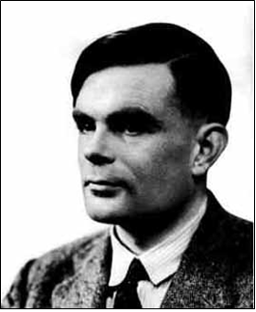
Turing Machines
In 1936, Turing introduced his abstract model for computation in his article “On Computable Numbers, with an application to the Entscheidungsproblem”.
Turing machine model was used to prove the unsolvable assuming that the intuitive notion of "effectively calculable“ (computability) is captured by the functions computable by a Turing machine.
Equivalently, Church also proved the same assumption by those expressible in the lambda calculus.
This assumption is now known as the Church–Turing thesis.
TM is similar to a finite automaton but with an unlimited and unrestricted memory, a Turing machine is a much more accurate model of a general purpose computer. A Turing machine model can model everything that a real computer can do.
Turing additionally proved many interesting theorems with his machine model which has become the standard model in theoretical computer science.
Alan M. Turing (1912–1954)

Slide 10
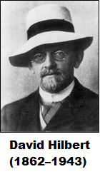
Hilbert’s 10th Problem
In 1900, mathematician David Hilbert identified 23 mathematical problems and posed them as a challenge for the coming century.
The tenth problem on his list concerned algorithms. The problem statement:
Determination of the solvability of a Diophantine equation.
Given a Diophantine equation with any number of unknown quantities and with rational integral numerical coefficients: To devise a process according to which it can be determined by a finite number of operations whether the equation is solvable in rational integers.
Let P(x₁, …, x_{k}) be a polynomial in k variables with integral coefficients. Does P have an integral root (x₁, …, x_{k})∈Z^{k} ?
Example: P(x, y, z) = 6x³yz + 3xy² – x³ – 10 has integral root (x,y,z) = (5,3,0)
Example: P(x, y) = 21x² – 81xy + 1 does not have an integral root.
Diophantine Equation

Slide 11
Diophantine Equation
Algorithm
Let’s briefly discuss polynomials to understand the problem.
A polynomial is a sum of terms, where each term is a product of certain variables and a constant, called a coefficient (here, we consider only integer coefficient). For example,
6 · x · x · x · y · z · z = 6x³yz² is a term with coefficient 6, and
6x³yz² + 3xy² − x³ − 10 is a polynomial with four terms, over the variables x, y, and z.
A root of a polynomial is an assignment of values to its variables so that the value of the polynomial is 0.
The above polynomial has a root at x = 5, y = 3, and z = 0.
Hilbert’s tenth problem was to devise an algorithm that tests whether a polynomial has an integral root. He did not use the term algorithm but rather “a process according to which it can be determined by a finite number of operations.”

Slide 12
Church-Turing Thesis
Algorithm
Proving that an algorithm exists or does not exist requires having a clear definition of algorithm.
The definition came in the 1936 papers of Alonzo Church and Alan Turing.
Church used notational system called the λ-calculus to define algorithms.
Turing did the same with his “machines.”
These two definitions were shown to be equivalent. This connection between the informal notion of algorithm and the precise definition has come to be called the Church–Turing thesis.
The Church–Turing thesis provides the definition of algorithm necessary to resolve Hilbert’s tenth problem.
Intuitive notion of algorithms equals to the Turing Decidable machine.
In 1970, Yuri Matijasevic, building on the work of Martin Davis, Hilary Putnam, and Julia Robinson, showed that no algorithm exists for testing whether a polynomial has integral roots.

Slide 13
Turing Recognizable vs Decidable
Review
Turing Recognizable: A language A is Turing-recognizable if and only if there is a Turing Machine M such that A = L(M).
w∈A ⟹ M halts on input w in state q_{ACCEPT},
w∉A ⟹ M halts on input w in state q_{REJECT}, or M runs forever (loop indefinitely)
Turing Decidable: A language A = L(M) is decided by the Turing Machine M, if M finishes in a halting configuration on every input w.
w∈A ⟹ M halts on input w in state q_{ACCEPT},
w∉A ⟹ M halts on input w in state q_{REJECT},

Slide 14
Hilbert’s tenth problem in TM
A simpler and analogous version to Hilbert’s tenth problem for polynomials with single variable, such as 2x²+x−7. Described in our terminology –
D1 = {p| p is a polynomial over x with an integral root}.
Here is a TM M1 that recognizes D1:
M1 = “On input 〈p〉: where p is a polynomial over the variable x.
Evaluate p with x set successively to the values 0, 1, −1, 2, −2, 3, −3, . . . . If at any point the polynomial evaluates to 0, accept.”
If p has an integral root, M1 eventually will find it and accept.
If p does not have an integral root, M1 will run forever.
For the multivariable case, we can present a similar TM M2 that recognizes D2 = {p| p is a polynomial with an integral root}.
Here, M2 goes through all possible settings of its variables to integral values.
Both M1 and M2 are recognizers but not deciders. So, no algorithm exists for Hilbert’s 10th problem; it is algorithmically unsolvable.

Slide 15
Algorithm
Informally, an algorithm (procedures or recipes) is a collection of simple instructions for carrying out some task.
Ancient mathematical literature contains descriptions of algorithms for a variety of tasks, such as finding prime numbers and greatest common divisors. In contemporary mathematics, algorithms abound.
Church-Turing Thesis Principle: Nothing will be considered an algorithm if it cannot be rendered as a Turing machine that is guaranteed to halt on all inputs, and all such machines will be rightfully called algorithms.
This is a principle not theorem which may/may not be proven till today/future (complexity theory).

Slide 16
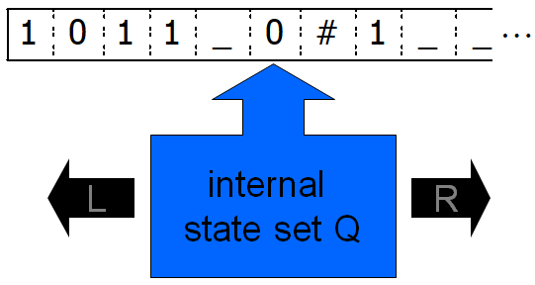
Informal Description
Turing Machine (TM)
At every step, the head of the Turing Machine named M reads a letter x_{i} from the one-way infinite tape.
Depending on its current state and the letter x_{i} being pointed by the head of the TM –
reads/writes a letter from/on the tape,
moves its read/write head left or right, and
jumps to a new state.

Slide 17
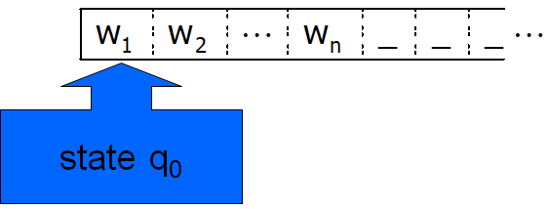
Input Convention
Turing Machine (TM)
Initially, the tape contains the input w∈Σ*, padded with blanks “_”, and the TM is in start state q₀.
During the computation –
the head moves left and right (but not beyond the leftmost point),
the internal state of the machine changes, and
the content of the tape is rewritten.

Slide 18
Input Convention: Simulation
Instruction:
Write A, Move right
Read N, Move right
Write N, Move left
q₁
q₀
q₂
Finite State Control
q₃
Head
 |  |  |  |  |  |  |  |  |  |  |  |  | …
I | N | P | U | T |  |  |  |  |  |  |  |  | …
A | N | P | U | T |  |  |  |  |  |  |  |  | …
A | N | N | U | T |  |  |  |  |  |  |  |  | …
Infinite Tape

Slide 19
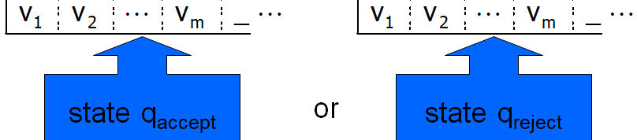
Output convention
Turing Machine (TM)
The computation completes/ends when the machines reaches one of the two halting states –
Accept State
Reject State
There is also a possibility for the machine not to complete/end the computation.
The computation can proceed indefinitely

Slide 20
Sipser-Introduction to the Theory of Computation 3E, Computability.
Lewis, Papadimitriou-Elements of Theory of Computation, 2ed, Turing Machine.
Hopcroft, Motwani, Ullman-Introduction to Automata Theory, Languages, and Computations, Turing Machine.

